Slide 1
Lecture 03 - Morphology
Prof. André Gustavo Hochuli
gustavo.hochuli@pucpr.br
aghochuli@ppgia.pucpr.br
Notes:
Prof. André Hochuli

Slide 2
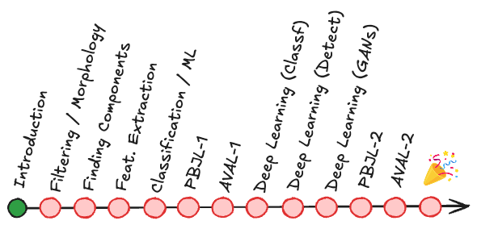

Topics
Discussion of Practice 02
Mathematical Morphology
Structuring Element (or Kernel)
Erode /Dilate
Open / Close
Gradients
Watershed
Practice
Computer Vision - Prof. André Hochuli
Lecture 03
Notes:
Prof. André Hochuli

Slide 3
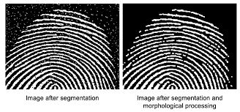
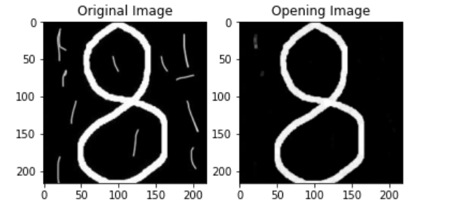


Mathematical Morphology
Morphology (Nature): Branch of Biology that study the form and structure of animals and plants
Morphology (Image Processing): Mathematical operations to extract image components based on pixel neighborhood.
Increase/Decrease Objects Size, Reduce Noise, Closing or Open (GAPS)
Computer Vision - Prof. André Hochuli
Lecture 03
Notes:
Prof. André Hochuli

Slide 4
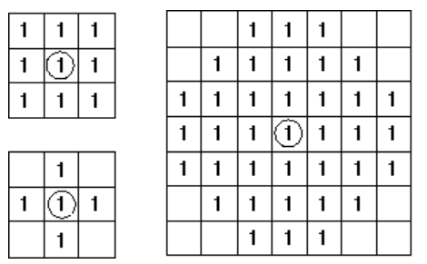
Structuring Element (Kernel)
Defines the shape of the structure to be applied
The structure is slid through the image
Erosion or Dilate operations are applied
The origin determines the pixel be changed
Computer Vision - Prof. André Hochuli
Lecture 03
Notes:
Prof. André Hochuli

Slide 5
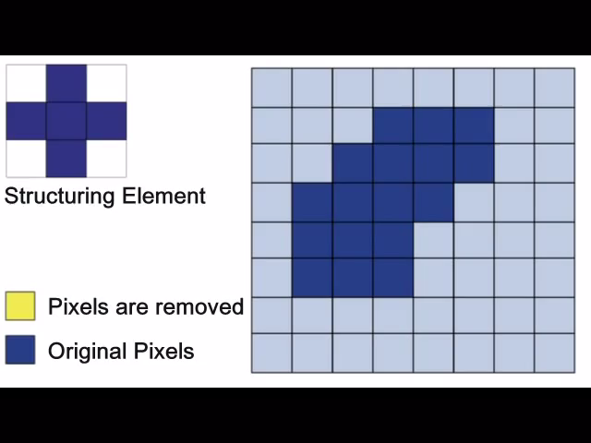
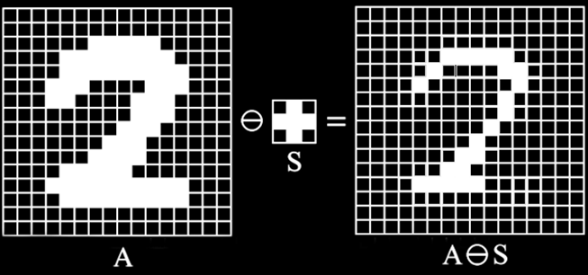
Erosion
Moves one’s to zero’s
Binary ‘AND’ Operation
Reduces Noises and Contours
Computer Vision - Prof. André Hochuli
Lecture 03
Notes:
Prof. André Hochuli

Slide 6
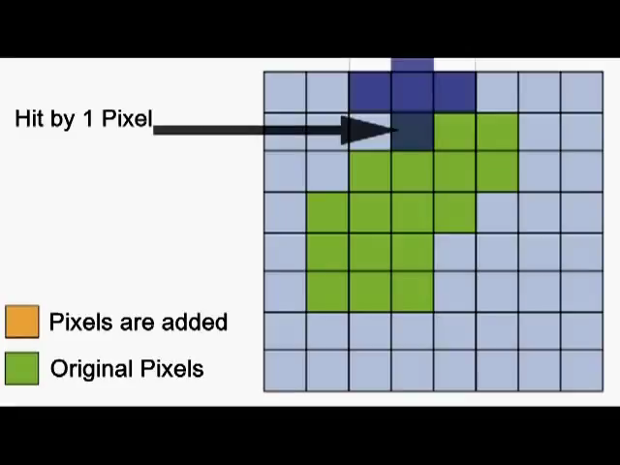
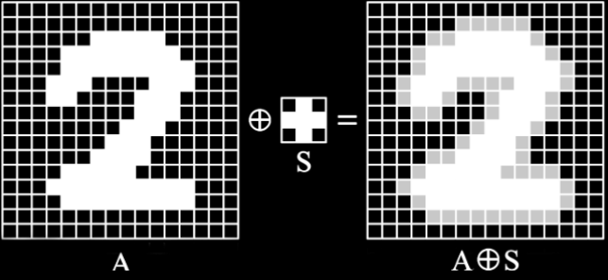
Dilation
Moves zero’s to one’s
Binary ‘OR’ Operation
Increases Objects, connects contours, and fill holes.
Computer Vision - Prof. André Hochuli
Lecture 03
Notes:
Prof. André Hochuli

Slide 7


Opening and Closing
Combined morphological operations that preserve the shape and size o large objects in the image
Opening: Erode + Dilate
Removes small objects, noises, and thin lines
Closing: Dilate + Erode
Fill small holes and connect segmented contours
Computer Vision - Prof. André Hochuli
Lecture 03
Notes:
Prof. André Hochuli

Slide 8


Others Morphological Operations
Gradient: Dilate - Erosion
Outline de Object
TopHat: Open – Original Image
Reduce the effect of brightness changes
Isolates brightness objects
Computer Vision - Prof. André Hochuli
Lecture 03
Notes:
Prof. André Hochuli

Slide 9
Let’s code!
Link: Morphology Operators
Computer Vision - Prof. André Hochuli
Lecture 03
Notes:
Prof. André Hochuli

